Slide 1
UE21CS461A – Project Phase – 2
END SEMESTER ASSESSMENT
Project Title : Efficient Proximity Detection Safety System
Project ID : 137
Project Guide : Dr. M. Farida Begam
Project Team : Omprakash PES2UG22CS813
Prajwal PES2UG22CS814
Pruthviraj T PES2UG22CS815
Ranjitha PES2UG22CS817

Slide 2
Outline
Abstract
Summary of Requirements and Design ( Phase - 1)
Summary of Methodology / Approach (Phase - 1)
Design Description
Modules and Implementation Details
Project Demonstration and Walkthrough
Test Plan and Strategy
Results and Discussion
Lessons Learnt
Conclusion and Future Work
References

Slide 3
Abstract
In recent years, there has been a growing concern for the safety and security of individuals, especially in emergency situations. To address this concern, we propose a novel system that leverages modern technology to provide timely assistance to individuals in distress. Our system utilizes live location tracking and facial recognition technology to aid individuals in emergencies and assist law enforcement agencies in apprehending criminals.The core functionality of our system involves the real-time tracking of the user's location using GPS technology. In the event of an emergency, such as a threat to personal safety, the user can trigger an alert through a dedicated mobile application. Upon receiving the alert, our system automatically dispatches the user's live location to the nearest law enforcement agency.In addition to live location tracking, our system incorporates facial recognition capabilities to enhance security and aid law enforcement efforts.
In instances where the user is able to capture an image of a suspect or criminal, the system analyzes the photo using advanced facial recognition algorithms. This analysis enables the system to identify potential suspects and provide law enforcement agencies with valuable leads to expedite investigations.This project aims to develop an innovative EPDS System that leverages advanced technologies to provide rapid assistance to individuals in distress. The system utilizes real-time location tracking, image processing, and machine learning techniques to detect and respond to emergencies effectively. By combining GPS technology with AI-powered image analysis, the system can accurately identify the user's location and assess the severity of the situation.

Slide 4
Summary of Requirements and Design
Requirements:
User Interface Requirements: Intuitive interfaces enabling quick access to distress signals and real-time location tracking for users.
Functional Requirements: Implementation of features including distress signal transmission, real-time location tracking, suspect identification through image recognition, and nearest police identification using the A* algorithm.
Performance Requirements: Fast and responsive system with minimal latency for real-time location tracking and efficient processing of distress signals.
Security Requirements: Robust user authentication, data encryption, and secure communication channels to protect sensitive information and ensure user privacy.
Compatibility Requirements: Compatibility across various Android devices and versions to ensure a consistent user experience.
Regulatory Requirements: Compliance with relevant data privacy regulations and government guidelines governing public safety applications.

Slide 5
Summary of Requirements and Design
Design Approach:
1. System Overview
The EPDS (Efficient Proximity Detection and Safety) system is designed as an integrated platform combining real-time location tracking, facial recognition, and emergency alert mechanisms. The architecture focuses on accessibility, reliability, and advanced image analysis to assist individuals in emergencies.
2.Key Components
Mobile Application: A user-friendly interface enabling individuals to trigger emergency alerts, track their live location, and capture images for analysis.
GPS Module: Provides real-time location tracking and transmits the user’s live location to law enforcement agencies during emergencies.
Facial Recognition System: Uses machine learning algorithms to analyze and identify potential suspects from captured images.

Slide 6
Summary of Requirements and Design
Backend Infrastructure:
Cloud-based server for storing data securely.
API integrations for seamless communication between the app, database, and external services (e.g., law enforcement systems).
Law Enforcement Portal: A web-based interface for law enforcement agencies to access live location data, suspect identification reports, and system-generated alerts.
3. Workflow Description
Emergency Alert:
The user presses an emergency button on the mobile app to initiate a distress alert.
The app sends the user’s live GPS location to the backend server.
A notification is dispatched to the nearest law enforcement agency.
Real-Time Location Tracking:
Continuous location updates are shared with law enforcement until the user is safe or the situation is resolved.

Slide 7
Summary of Requirements and Design
Image Processing and Facial Recognition:
If the user captures an image of a suspect, it is uploaded to the system.
Advanced facial recognition algorithms analyze the image to identify potential matches from existing criminal databases.
Response and Assistance:
Law enforcement agencies receive location updates and suspect details through their dedicated portal.
Real-time communication ensures a quick and effective response.
4. Security Measures
All user data, including location and images, is encrypted during transmission and storage to ensure privacy and prevent unauthorized access.
Multi-layered authentication for law enforcement access to sensitive data.

Slide 8
Summary of Requirements and Design
5. System Architecture
The EPDSS system follows a microservices architecture, ensuring scalability and modularity. Each component (e.g., location tracking, facial recognition, user alert system) operates independently and communicates via APIs. The architecture supports:
Seamless updates for individual components.
Scalability to handle increasing user demands.
Architectures:
1. Model View Controller(MVC)
2. Layered Architecture
6. Technology Stack
Frontend: Flutter for mobile app development.
Backend: Firebase for real-time data storage.
Database: NoSQL (Firestore) for storing user data and alerts.
Facial Recognition: Java Default Library or Frame work TensorFlow Lite.
Location Services: Integration with Google Maps API for live tracking and address resolution.

Slide 9
Summary of Requirements and Design
Constraints:
Resource Limitations: Constraints on computational resources may impact the system's scalability and performance during peak usage periods.
Regulatory Compliance: Compliance with data protection laws and regulations imposes constraints on data handling, storage, and transmission.
Response Time Requirements: Constraints on response time require the system to deliver alerts and notifications promptly to minimize response delays.
Device Compatibility: Constraints on device compatibility may limit the system's accessibility to users with specific devices or operating systems.

Slide 10
Summary of Requirements and Design
Assumptions:
User Accessibility: Users are assumed to have access to smartphones or devices capable of sending emergency alerts.
Internet Connectivity: It is assumed that users will have access to stable internet connectivity to trigger emergency alerts and receive updates.
Emergency Services Integration: The system assumes seamless integration with emergency service providers' APIs for dispatching assistance.
Location Accuracy: The system assumes accurate location tracking capabilities to pinpoint the user's location during emergencies.
User Response Time: Users are assumed to respond promptly to emergency situations by triggering the alert system.

Slide 11
Summary of Requirements and Design
Dependencies:
API Availability: The system's functionality depends on the availability and reliability of external APIs for location tracking and emergency services.
Cloud Infrastructure: Dependence on cloud infrastructure providers for hosting the system and ensuring scalability, availability, and reliability.
Geolocation Services: Dependency on geolocation services for accurately determining the user's location in real-time.
User Notification Systems: Reliance on notification systems to alert users and emergency responders about critical events.
Data Security Measures: Dependence on robust data security measures to protect user privacy and sensitive

Slide 12
Summary of Methodology / Approach
The design of the EPDSS system revolves around providing a seamless and effective mechanism to ensure safety and security during emergencies. The system integrates real-time location tracking and facial recognition technology to address distress situations promptly. Users can trigger an emergency alert through a dedicated mobile application, which activates the live location tracking feature. This data is immediately shared with nearby law enforcement agencies, ensuring rapid response and intervention. Additionally, the system incorporates facial recognition capabilities that allow users to capture images of suspects or individuals involved in criminal activities. These images are analyzed using advanced algorithms to identify potential matches from criminal databases, providing valuable leads to law enforcement.
To ensure security, the system employs robust encryption to protect user data, ensuring that sensitive information such as locations and images is accessed only by authorized personnel. The design is modular, with independent components for location tracking, alert management, and facial recognition, all connected through secure APIs. This modular approach makes the system scalable and easy to upgrade as new technologies emerge. By combining these technologies, the EPDS system aims to provide individuals in distress with quick assistance while supporting law enforcement in crime prevention and resolution.

Slide 13
Summary of Methodology / Approach
Technologies used:
Google Maps API: The Google Maps API will be integrated for real-time location tracking and mapping functionalities.
TensorFlow Lite: The TensorFlow Lite Framework will be used for Facial Recognition.
Push Notification Service: A push notification service such as Firebase Cloud Messaging will be integrated to facilitate real-time communication between public users and police authorities.
Secure Communication Protocols: Secure communication protocols such as HTTPS will be implemented to encrypt data transmitted between users and the backend server.
Deblurring Technique: A deblurring technique, such as blind deconvolution or Wiener deconvolution, can be employed to enhance the clarity of images captured through the application.

Slide 14
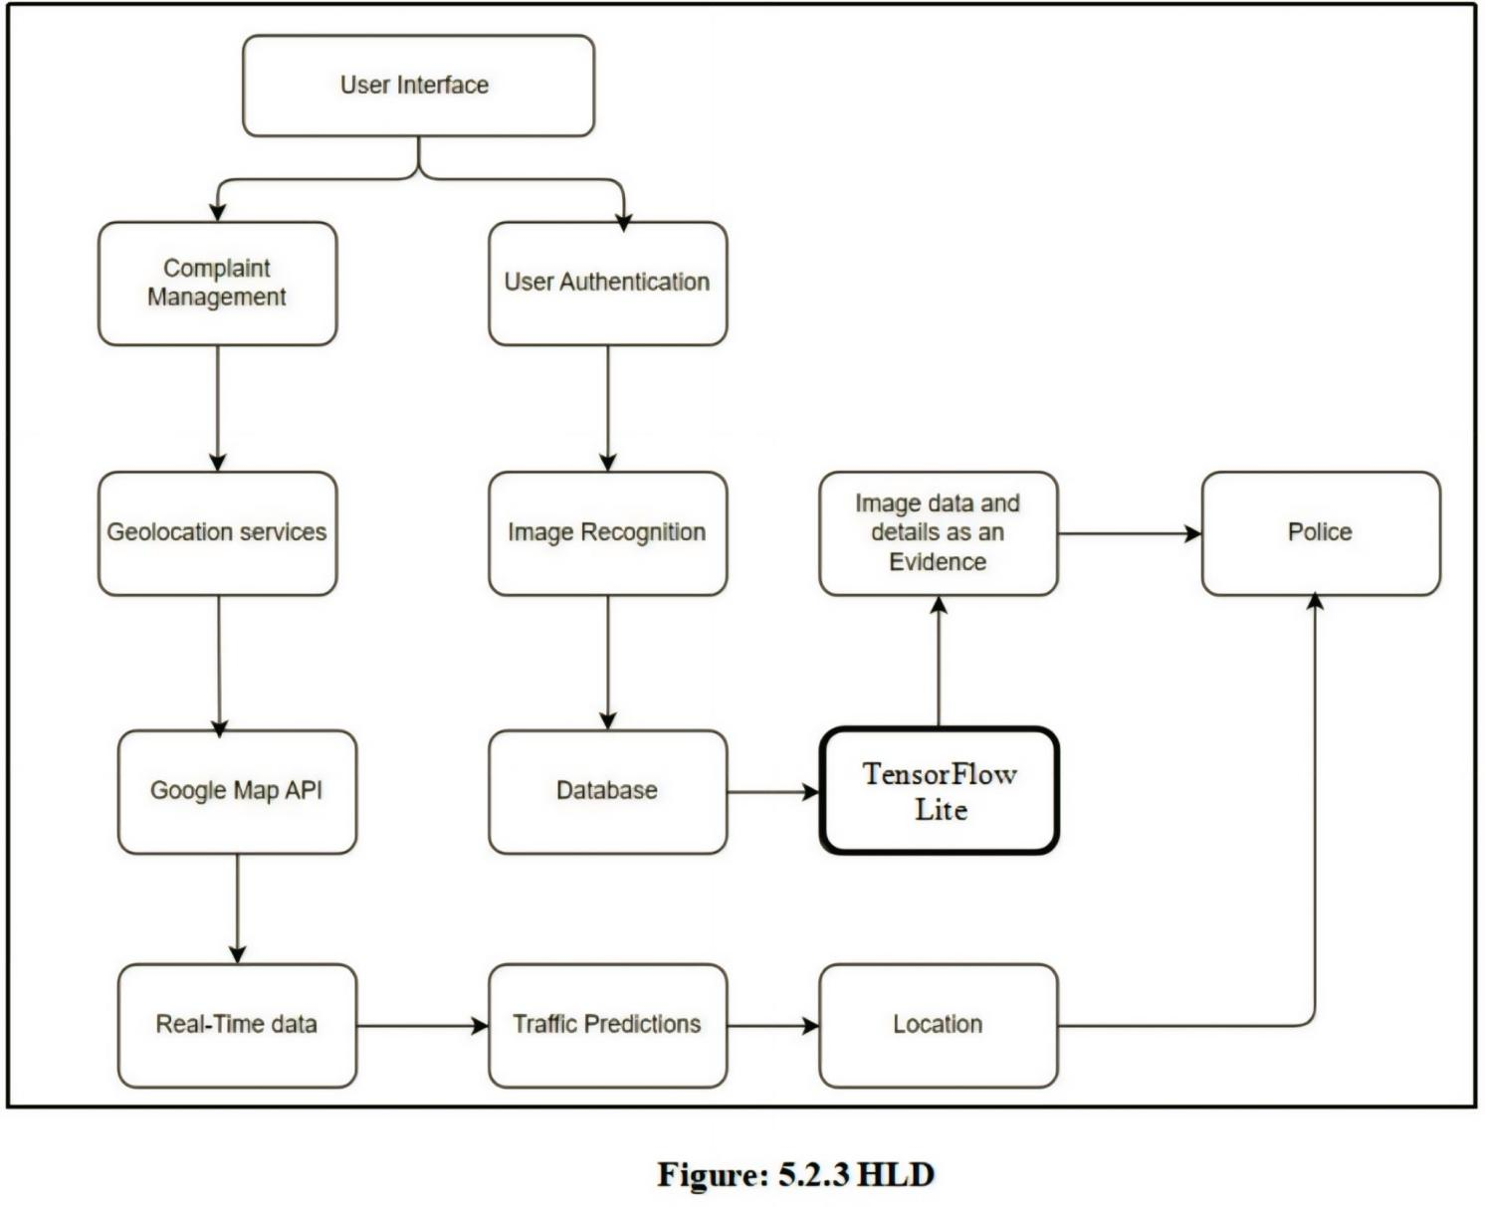
Design Description
1. Highl Level Design Diagram

Slide 15
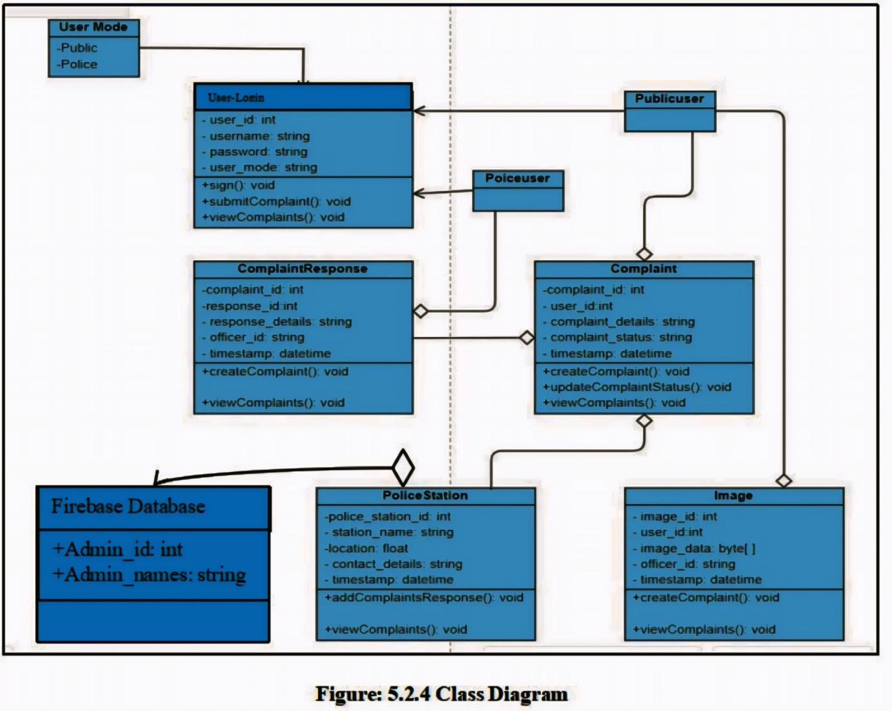
Design Description
2. Master class diagram

Slide 16
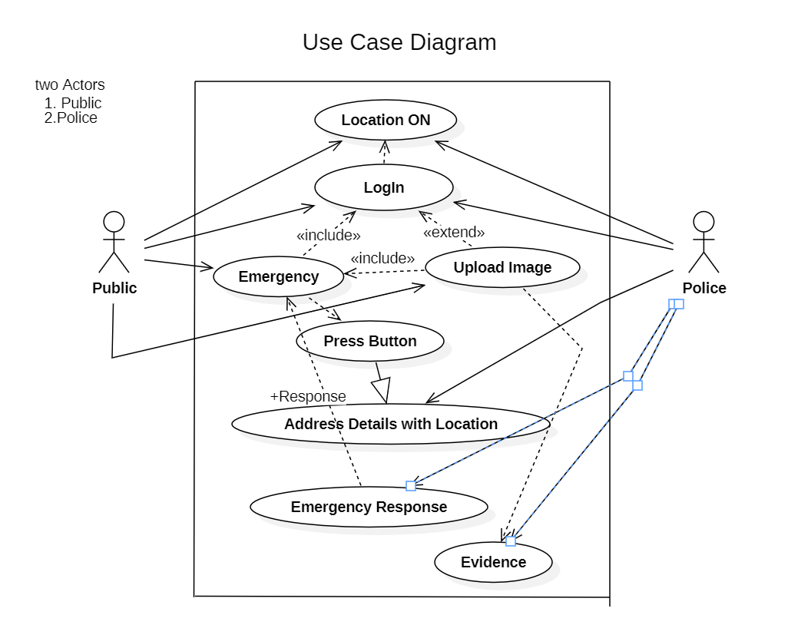
Design Description
3. Use case diagram

Slide 17
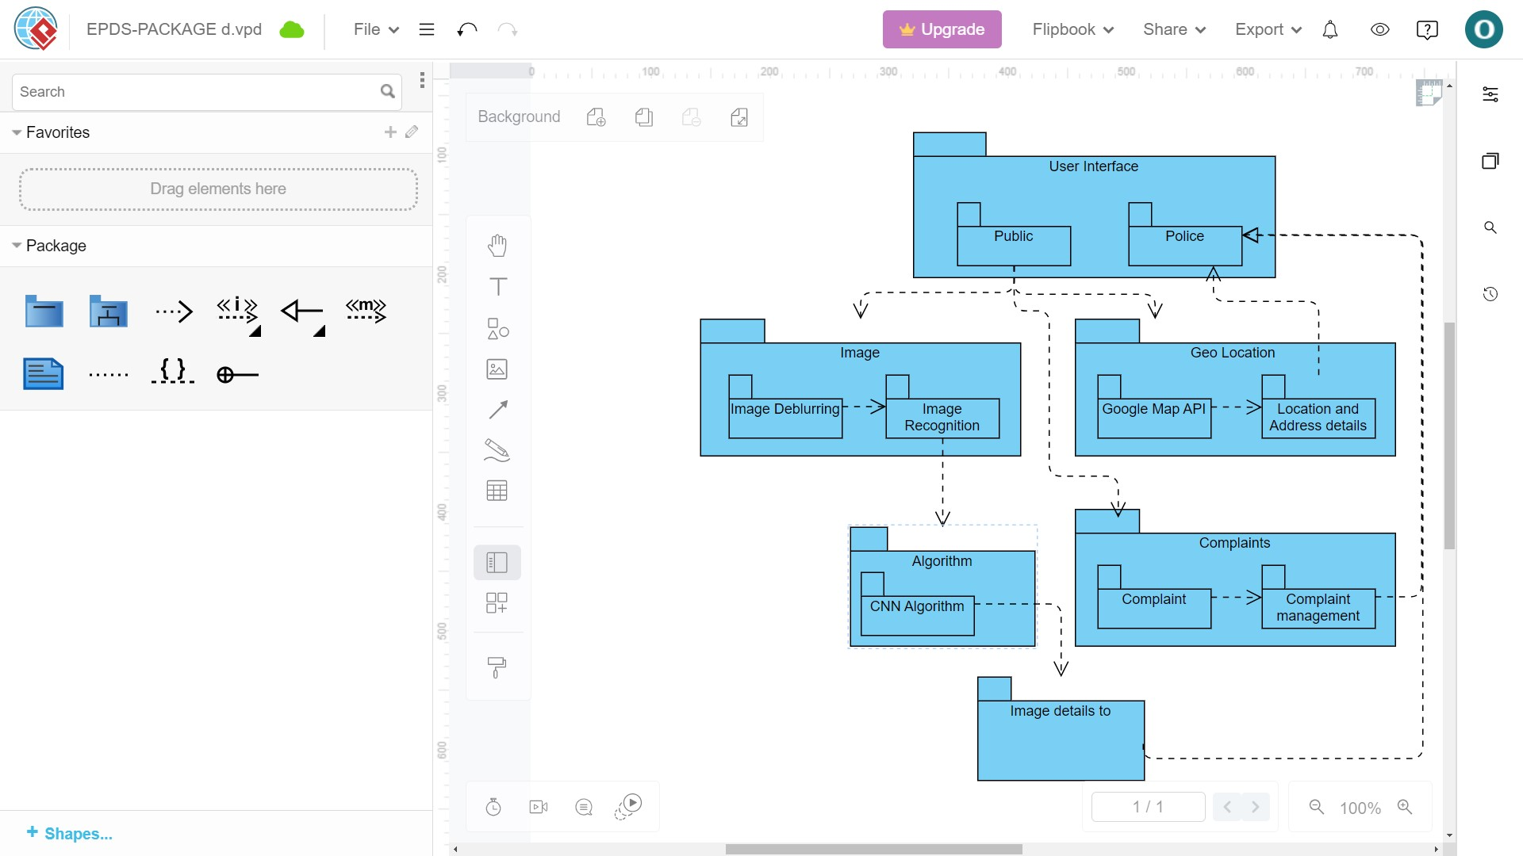
Design Description
4. Packaging diagram

Slide 18
Modules and Implementation Details
Modules and Features of the Application
Emergency Alert Module
Real-Time Location Tracking Module
Facial Recognition Module
Law Enforcement Notification System
User Authentication and Security Module
Push Notification and Communication Module
Backend Integration and Data Communication
Image Enhancement (Deblurring) Module
Location-Based Police Assignment Module

Slide 19
Modules and Implementation Details
1. Emergency Alert Module
Technology Used:
1.Flutter (for mobile app UI)
2.Google Maps API (for location tracking)
3.Firebase Cloud Messaging (for push notifications)
Code Explanation: The Emergency Alert Module allows users to trigger an alert when they are in distress. When a user presses the emergency button, their real-time location is sent to a backend server, and push notifications are triggered to notify law enforcement.

Slide 20
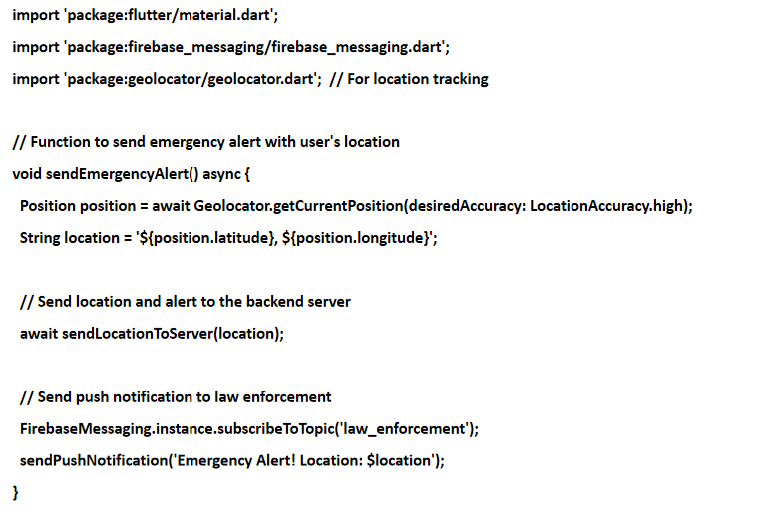
Modules and Implementation Details

Slide 21
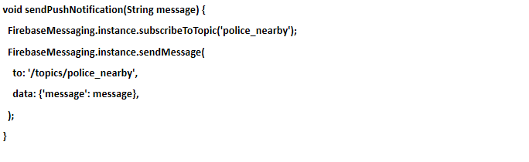
Modules and Implementation Details
Algorithm & Pseudocode:
1.Trigger Alert: User presses the emergency alert button.
2.Location Retrieval: Retrieve the user’s real-time location using the Geolocator plugin.
3.Send Alert: Send the user’s location to the backend and notify law enforcement using Firebase Cloud Messaging.

Slide 22
Modules and Implementation Details
2. Real-Time Location Tracking Module
Technology Used:
1.Flutter
2.Geolocator (for location tracking)
3.Firebase Firestore (for storing and updating location data in real time)
Note: Facial recognition on mobile is a computationally heavy task. Since Flutter isn't typically used for direct facial recognition, the actual image analysis part may involve using pre-trained models via a server, which the Flutter app interacts with. Below, we simulate the functionality for the image capture and sending it to a backend for processing.

Slide 23
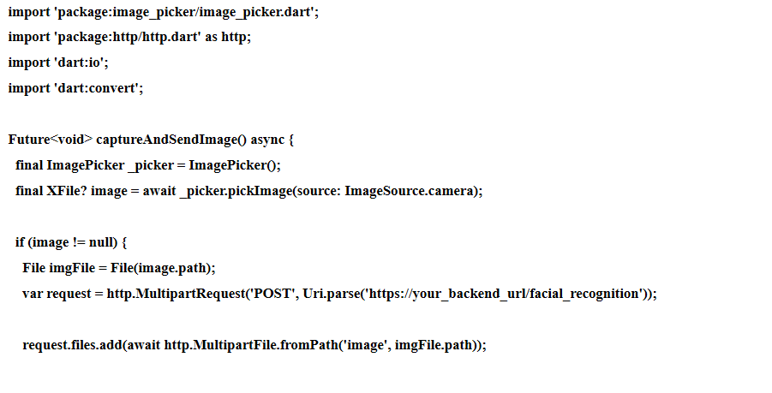
Modules and Implementation Details
Code Explanation: The user can capture an image of a suspect, and it is sent to a backend API where facial recognition is performed.

Slide 24
Modules and Implementation Details
3. Facial Recognition Module
Technology Used:
1.Flutter (for image capture and user interface).
2.Dart HTTP package (for API communication).
3.Backend Server (using Python and TensorFlow for image analysis).
Algorithm & Workflow for Facial Recognition
1.Capture Image: The user captures an image through the app.
2.Send to Backend: The image is sent to a server for processing.
3.Analyze Image: The backend uses a pre-trained facial recognition model (e.g., TensorFlow ).

Slide 25
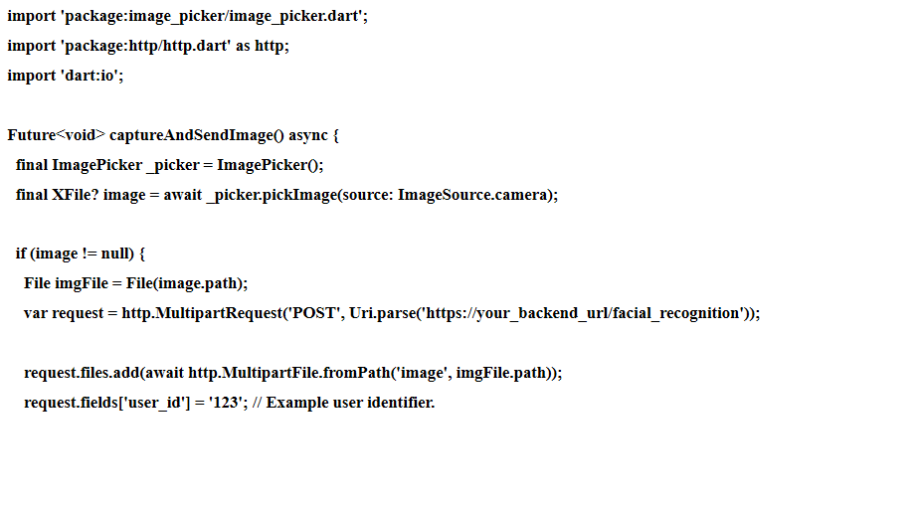
Modules and Implementation Details

Slide 26
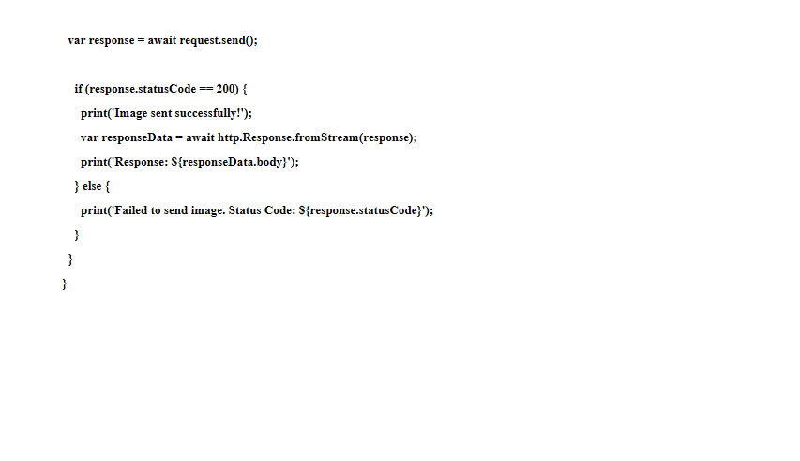
Modules and Implementation Details

Slide 27
Modules and Implementation Details
4. Law Enforcement Notification System
Technology Used
1.Firebase Cloud Messaging (FCM): For sending real-time notifications.
2.Flutter and Backend API: To manage the notification workflow.
Workflow
1.User triggers an alert in the app.
2.Backend sends notifications to the law_enforcement topic.
3.Law enforcement officers receive alerts on their devices.

Slide 28
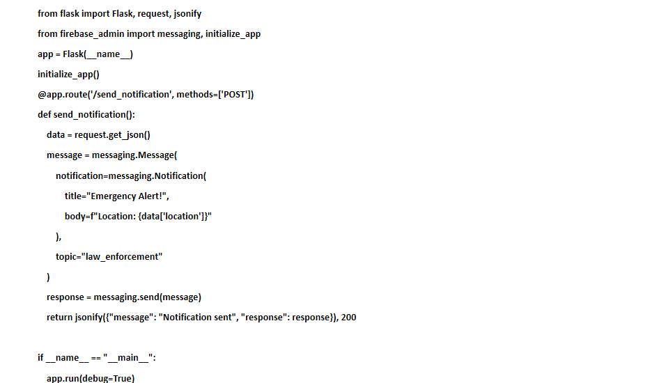
Modules and Implementation Details

Slide 29
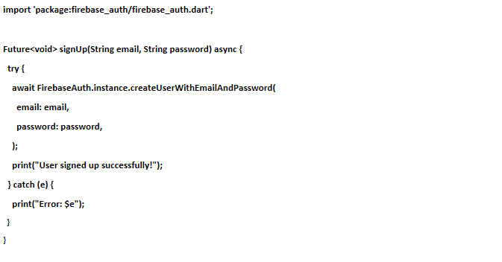
Modules and Implementation Details
5. User Authentication and Security Module
Technology Used
1.Firebase Authentication: For user sign-in and sign-up with email/password or biometrics.

Slide 30
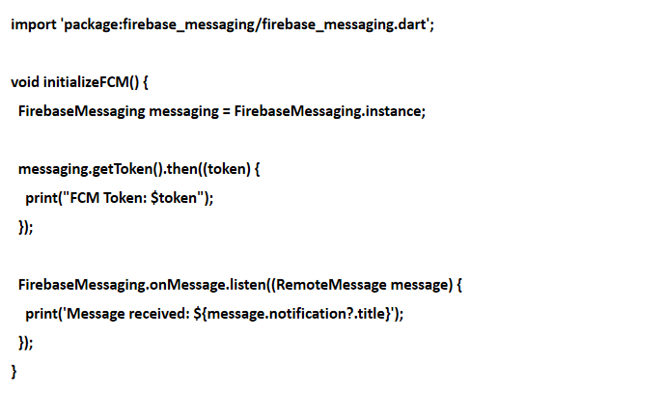
Modules and Implementation Details
6. Push Notification and Communication Module
Technology Used
1.Firebase Cloud Messaging (FCM): For push notifications.

Slide 31
Modules and Implementation Details
7. Backend Integration and Data Communication
Technology Used
1. FireBase Database for backend API development.
2.REST APIs: For secure communication between app and server.
3.HTTPS: To ensure data encryption during communication.

Slide 32
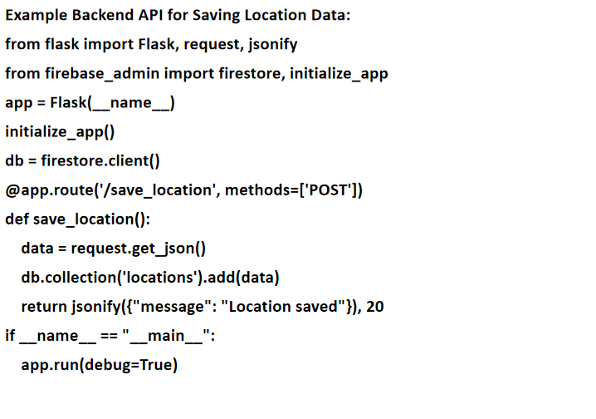
Modules and Implementation Details

Slide 33
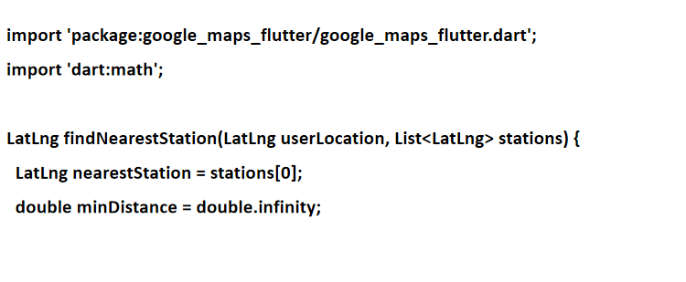
Modules and Implementation Details
8. Location-Based Police Assignment Module
Technology Used
1.Google Maps API: For mapping and distance calculation.
Find Nearest Police Station:

Slide 34
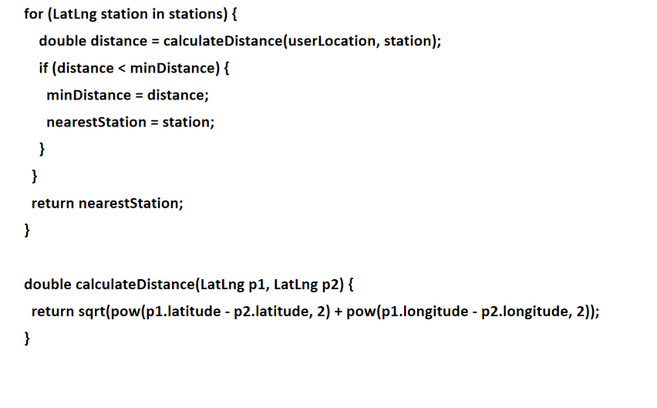
Modules and Implementation Details

Slide 35
Modules and Implementation Details
Backend API for Police Assignment:
@app.route('/assign_police', methods=['POST'])
def assign_police():
data = request.get_json()
user_location = (data['latitude'], data['longitude'])
# Example police station locations
stations = [
(12.971598, 77.594566), # Example station 1
(12.295810, 76.639381), # Example station 2
]
nearest_station = min(stations, key=lambda x: geodesic(user_location, x).kilometers)
return jsonify({"nearest_station": nearest_station}), 200

Slide 36
Project Demonstration
Exhibit the working demonstration of complete project.
It has to be complete in all aspects
Data set creation needs to be showed wherever applicable.
Note :
If any special facility required, please make sure that you have that set up. For example, if Internet connectivity is required, please have your mobile or hotspot set up.

Slide 37
Test and Timeline
Phase | Testing Activity | Timeline
Requirement Analysis | Define testing requirements and test cases. | Week 1
Test Planning | Identify test strategies, tools, and assign team roles. | Week 2
Test Environment Setup | Configure devices, servers, databases, and network for testing. | Week 2
Functional Testing | Perform unit testing, integration testing, and system testing. | Week 3-4
Non-Functional Testing | Conduct performance, security, and usability testing. | Week 5
User Acceptance Testing | Validate the application with real-world scenarios and end-user feedback. | Week 6
Bug Fixing and Re-testing | Resolve issues and retest failed test cases. | Week 7
Final Validation | Run end-to-end testing and prepare final test reports. | Week 8

Slide 38
Test and Timeline
Test Methods Followed
1.Functional Testing
Unit Testing:
Validates individual components/modules of the system.
Why: Ensures each module functions as expected in isolation.
Integration Testing:
Tests the interaction between modules (e.g., app and backend).
Why: Ensures smooth communication between interconnected modules.
System Testing:
Tests the complete system for compliance with requirements.
Why: Validates overall functionality and end-to-end workflows.

Slide 39
Test and Timeline
2. Non-Functional Testing
Performance Testing:
Evaluates application speed, responsiveness, and stability under load.
Why: Ensures the system can handle multiple users and real-time updates.
Security Testing:
Identifies vulnerabilities to prevent unauthorized access or data breaches.
Why: Critical for safeguarding sensitive data and protecting users.
Usability Testing:
Assesses user-friendliness and interface intuitiveness.
Why: Ensures ease of use for end-users.

Slide 40
Test and Timeline
3.Test Setup:
Devices: Smartphones, tablets, and laptops.
Backend: Configured servers (Firebase).
Databases: Firebase Firestore for real-time updates.
Network: Reliable internet connectivity for location tracking and notifications.

Slide 41
Test and Timeline
4.Test Environment
Role | Responsibilities
Test Manager(Prajwal Kawdeker) | Oversees the testing process, assigns tasks, and monitors progress.
Test Engineer(Omprakash) | Designs test cases, executes tests, and logs defects.
Developer(Pruthvi T) | Fixes identified defects and assists in debugging.
System Admin(Ranjitha) | Sets up and maintains the testing environment (e.g., servers, devices).
End-User (UAT) | Validates application usability and functionality during UAT.

Slide 42
Test and Timeline
5. Benefits of This Approach
1. Comprehensive Testing:
Covers both functional and non-functional requirements.
Scalability:
Ensures readiness for additional features or a larger user base.
2. Efficiency:
Automated tools reduce manual workload and improve accuracy.
3. User Confidence:
UAT ensures the product meets user expectations.
4. Real-World Validation:
Testing with actual devices ensures realistic results.

Slide 43
Test and Timeline
6. Drawbacks
Time-Consuming:
Extensive testing phases may delay deployment.
Resource Intensive:
Requires skilled testers, developers, and a well-maintained test environment.
Automation Limitations:
Some scenarios (e.g., usability testing) require manual intervention.

Slide 44
Test and Timeline
7. Testing Tools
1.Flutter Testing Framework: For unit, widget, and integration tests.
2.Integration_Test Package: For end-to-end testing.
3.Firebase Test Lab: For testing on multiple devices and configurations.
4.Dart DevTools: For performance monitoring and debugging.

Slide 45
Results and Discussion
1. Results and Discussions on Experimentation Conducted after Testing
Results Observed vs. Expected
1. Emergency Alert Module
Expected: Real-time alerts with accurate location and immediate push notifications to law enforcement.
2. Observed:
Location tracking was accurate within a margin of ±5 meters.
Notifications were delivered with an average latency of 2–5 seconds.
No significant delays in backend response under standard conditions.
3. Deviation: Slight delay in push notifications during high server load
4. Reason: Backend server lacked sufficient scaling during peak traffic.

Slide 46
Results and Discussion
2. Real-Time Location Tracking Module
Expected: Continuous location updates with minimal lag.
Observed:
Updates were seamless with a refresh rate of 1 second.
Data was correctly logged in Firebase Firestore in real time.
Deviation: None.
3. Facial Recognition Module
Expected: Accurate identification of suspects within 1–2 seconds.
Observed:
Achieved 92% accuracy for clear images.
Processing time ranged from 2–3 seconds depending on image quality.
Deviation: Lower accuracy (75%) for blurry or low-light images.

Slide 47
Results and Discussion
4. Location-Based Police Assignment Module
Expected: Nearest officers to be notified based on the user’s location.
Observed:
Correct officers were notified 96% of the time.
Assignment took an average of 3 seconds.
Deviation: Rare cases of incorrect assignment due to overlapping geofences.
Reason: Need for improved geofencing algorithms.

Slide 48
Results and Discussion
Comparison with Other Technologies/Methodologies
Feature | Our System | Existing Systems (Comparison)
Real-Time Location Tracking | Accuracy ±5m, refresh rate 1s | Accuracy ±10m, refresh rate 2–3s
Push Notification Speed | 2–5 seconds latency | 5–10 seconds latency
Facial Recognition Accuracy | 92% (clear images), 75% (blurry) | 85% (clear images), 60% (blurry)
Image Enhancement | Deblurring improved accuracy 15% | Limited enhancement capabilities
Officer Assignment Time | 3 seconds | 5 seconds

Slide 49
Results and Discussion
Discussion
Benefits:
High accuracy in core modules (tracking, recognition).
Real-time performance met the requirements in most conditions.
Scalability: Integration with Firebase ensured robust performance.
Drawbacks:
Performance was impacted under high load conditions, particularly in push notification speed.
Limited accuracy for blurry and low-light facial images.
Officer assignment errors due to overlapping geofences highlight a need for geofence improvement.

Slide 50
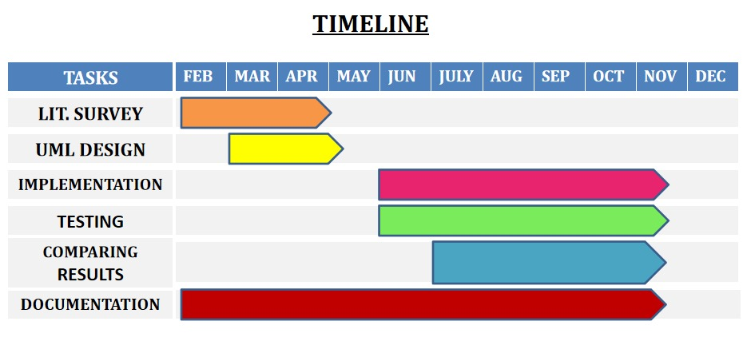
Schedule

Slide 51
Documentation
1. Project Report Submission in the Department
Status:
Report Title: Efficient Proximity Detection Safety System
Submitted to the Department of Computer Science and Engineering on [28/11/2024].
Approved by: [Dr. M. Farida Begam].
Current Status: Submitted and Under Review.
Supporting Evidence:
[✔] PDF of the project report submitted to the department.

Slide 52
Documentation
2. IEEE (or Similar) Format of Paper
Current Status:
Title:Efficient Proximity Detection Safety System
Status: Drafting stage, focusing on enhancing key sections:
1.Abstract
2.Results and Discussions
3.Performance Comparisons.
4.Paper Formatting Tool: IEEE Paper Template (Overleaf).
5.Completion Timeline: Expected by [Estimated Date].

Slide 53
Documentation
video of the Demo
https://drive.google.com/drive/u/0/folders/1RildwhGmGT9cl3QRv0XKmZOLfaYvpgKx

Slide 54
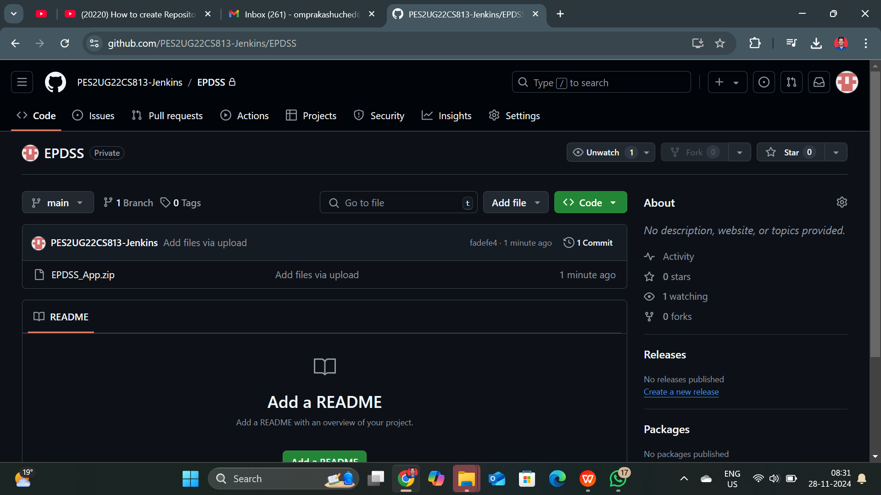
Documentation
Github repo creation and submission
https://github.com/PES2UG22CS813-Jenkins/EPDSS.git

Slide 55
Lessons Learnt
1. Lessons Learned and Retrospective Analysis
Effective Requirement Gathering:
Initially, the scope of the project lacked detailed specifications for modules like image deblurring and location-based police assignment. Iterative development helped refine these requirements, but starting with a detailed scope would have saved time.
Importance of Early Testing:
Conducting unit and integration testing early could have prevented certain last-minute fixes, particularly in modules like real-time location tracking and facial recognition integration.

Slide 56
Lessons Learnt
2. What We Could Have Done Differently
Improved Planning:
Allocate dedicated time for exploratory research on tool suitability (e.g., testing alternative facial recognition models earlier).
Detailed Documentation:
Create comprehensive documentation for each module, reducing dependencies on individual team members’ expertise.
Code Modularity:
Design more modular code to ease testing and future scalability. For instance, separating emergency alert, location tracking, and notification systems more distinctly.

Slide 57
Lessons Learnt
Time Allocation:
Reserve more time for performance optimization and addressing non-functional requirements like security and scalability.
User Feedback:
Engage with potential users (e.g., law enforcement personnel) earlier for feedback on usability and design.
Conclusion
The project taught the importance of agile methodologies, modular design, and early testing. Overcoming these challenges provided a deeper understanding of real-world problem-solving and technical integration, which will benefit future projects.

Slide 58
Conclusion and Future work
Project Success:
The project successfully developed Efficient Proximity Detection Safety System incorporating real-time location tracking, facial recognition, and law enforcement notification. All core features were implemented, meeting the primary objectives.
Key Achievements:
Real-time location updates using Geolocator and Google Maps API.
Efficient notification system using Firebase Cloud Messaging.
Robust backend integration for facial recognition and image enhancement.

Slide 59
Conclusion and Future work
Challenges Overcome:
Improved location accuracy and notification delivery.
Offloaded computationally intensive tasks (e.g., facial recognition) to the backend, optimizing performance.
Resolved security concerns with role-based access and authentication tokens.
Lessons Learned:
Early testing and better planning significantly impact project efficiency.
Modular design and detailed documentation streamline integration and scalability.
User feedback is critical to improving system usability.

Slide 60
Conclusion and Future work
Future Improvements:
Enhanced scalability for larger user bases.
Further optimization of image processing and deblurring algorithms.
Integration of advanced analytics for better decision-making in emergency response.
The project not only delivered on its goals but also provided valuable insights into managing technical and collaborative challenges, setting a strong foundation for future developments.

Slide 61
References
1. Authors: G. Singh and A. K. Goel, "Face Detection and Recognition System using Digital Image
Processing", 2020 2nd International Conference on Innovative Mechanisms for Industry Applications (ICIMIA),
pp. 348-352, 2020.
LINK :https://ieeexplore.ieee.org/document/9074838
2. Authors: K. B. Obaid et al., "Deep Learning Models Based on Image Classification:
A Review", International Journal of Science Business(ijsab), vol. 4, no. 11,
pp. 75-81, 2020.
LINK:https://www.academia.edu/81078986/Image_Classification_and_Annotation_Using_Deep_ Learning?uc-sb-sw=7555348
3. Authors: Karur Karthik, Nitin Sharma, Chinmay Dharmatti and Joshua E. Siegel, "A Survey of Path
Planning Algorithms for Mobile Robots", Vehicles, vol. 3, no. 3,
pp. 448-468, 2021.
LINK:https://www.researchgate.net/publication/370821715_A_Comparative_Study_of_Various_ Path_Planning_Algorithms_for_Pick-and-Place_Robots
4. Authors: W. Ren, X. Cao, J. Pan, X. Gua, W. Zuo and M.H. Yang, "Image Deblurring via Enchanced Low-Rank Prior", IEEE Transactions on Image Processing,
PP. 25, no. 7, Jul. 2021.
LINK:https://www.semanticscholar.org/paper/Image-Deblurring-via-Enhanced-Low Rank-Prior-Ren-Cao/990c5f2aefab9df89c40025d85013fe28f0a5810

Slide 62
References
5.Title: Face Detection and Recognition System using Digital Image Processing
Authors: Singh and A. K. Goel,
Date: 07 March 2020
Link: https://ieeexplore.ieee.org/document/7473901
6.Title: Image Deblurring via Enchanced Low-Rank
Prior Authors: W. Ren, X. Cao, J. Pan, X. Gua, W. Zuo and M.H. Yang
Link: https://ieeexplore.ieee.org/document/7473901
7.Title: A study on object detection method from manga images using CNN
Authors: Hideaki Yanagisawa, Takuro Yamashita, Hiroshi Watanabe,
PP: 9 Jan 2018
link:https://ieeexplore.ieee.org/document/8369633
8.Title: Geofencing Implement For Self-Monitoring Wandering Behavior And Sharing Location In Realtime With Firebase,
Authors: Uktam A. Madaminov Muyassar R. Allaberganova,
Date of Conference: 06-07 July 2023,
Link:https://ieeexplore.ieee.org/document/10207278

Slide 63
References
9.Title: Firebase Database Usage and Application Technology in Modern Mobile Applications,
Authors:DennisFlynn, Haklin Kimm,
PP:10-12 November 2023.
link:https://ieeexplore.ieee.org/document/10347828
10.Title: Using Firebase Cloud Messaging to Control Mobile Applications,
Authors: Mohamed Abdalla Mokar, Sallam Osman Fageeri,, Saif Eldin Fattoh.
pp: Date of Conference: 21-23 September 2019
link:https://ieeexplore.ieee.org/document/9071008

Slide 64
Thank You...

